Slide 1
Flash FS
Yubin Xia

Slide 2
Review: Transaction Semantics in xv6
begin_trans:
need to indicate which group of writes must be atomic!
lock -- xv6 allows only one transaction at a time
log_write:
record sector #
append buffer content to log
leave modified block in buffer cache (but do not write)
commit_trans():
record "done" and sector #s in log
do the writes
erase "done" from log
recovery:
if log says "done": copy blocks from log to real locations on disk

Slide 3
Review: Committing a transaction to disk
open a new transaction, for subsequent syscalls
mark transaction as done
wait for in-progress syscalls to stop()
(maybe it starts writing blocks, then waits, then writes again if needed)
write descriptor to log on disk w/ list of block #s
write each block from cache to log on disk
wait for all log writes to finish
append the commit record
now cached blocks allowed to go to homes on disk (but not forced)

Slide 4
Review: Ordered Mode vs Journaled Mode
journaling file content is slow, every data block written twice
perhaps not needed to keep FS internally consistent
can we just lazily write file content blocks?
no:
if metadata updated first, crash may leave file pointing to blocks with someone else's data
ext3 ordered mode:
write content block to disk before committing inode w/ new block #
thus won't see stale data if there's a crash
most people use ext3 ordered mode

Slide 5
Similar Problem in NV-RAM
Consider using NV-RAM as disk
CPU Cache now becomes the memory
Crash will lose data in cache (not written back)
L1
L1
L2
L2
LLC
LLC
Memory
(DRAM)
Memory
(NVM)
Disk Storage
Disk Storage

Slide 6
Similar Problem in NV-RAM
CPU has instructions to flush cache to memory
Clflush: cache line flush
Clflushopt: a similar version
Clwb: cache line write back
Pcommit: Persistency commit

Slide 7
INTRO TO FLASH FILE SYSTEM

Slide 8
What is flash file system?
Flash file system is designed for storing files on flash memory devices
Can traditional file systems be used on flash file system?
Of course, NO.
So, what is the big difference between flash disk and magnetic disk

Slide 9
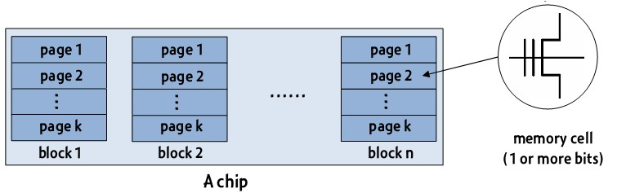
Flash disk organization (1/2)
Flash disk organization
A chip (e.g. 1GB) => blocks (e.g. 512KB) => pages (e.g. 4KB) => cells

Slide 10
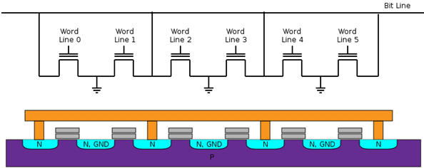
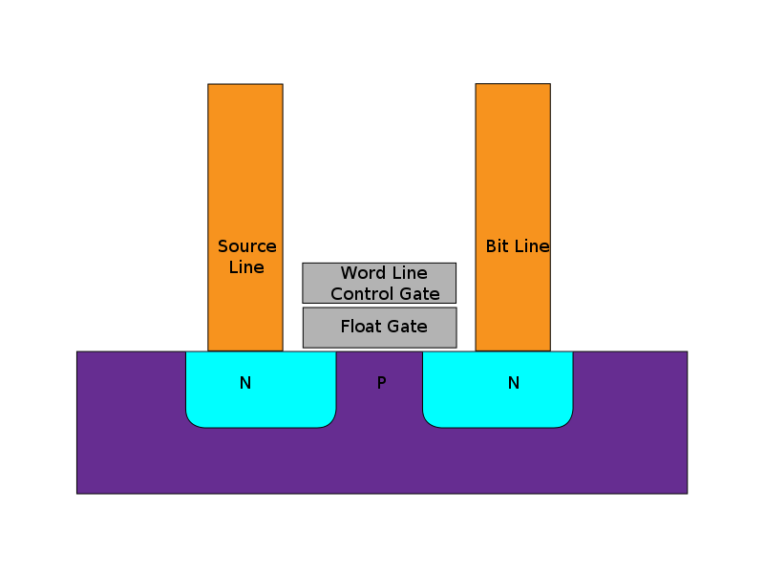
Flash disk organization (2/2)
Flash cell: a floating gate transistor
The number of electrons on the floating gate determines the threshold voltage V
The threshold voltage represents a logical bit value (0 or 1)
(Single-Level Cell, SLC)
(Multi-Level Cell, MLC)

Slide 11
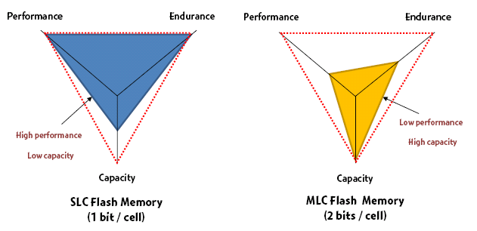
Comparisons of SLC and MLC Flashes

Slide 12
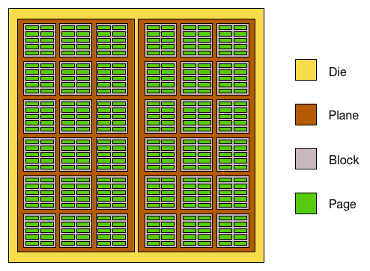
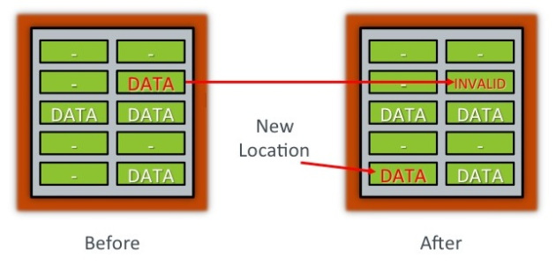
Flash disk characters (1/2)
Asymmetric read/write and erase operations
A “page” is a unit of read/write (8-16KB)
A “block” is a unit of erase (4-8MB)
Physical restrictions
Erase-before-write restriction
The number of erase cycles allowed for each block is limited

Slide 13
Flash disk characteristics (2/2)
Random access
Disk file system are optimized to avoid disk seeks whenever possible
Flash device impose no seek latency
Wear leaving
Flash device tend to wear out when a single block is repeatedly overwritten
Designed to spread out writes evenly
Heterogeneous cells
SLC (single level cell) and MLC (multi level cell)

Slide 14
Flash for File Storage
Simplest method – direct 1:1 mapping
Good for read-only operations
No wear levelling
Very unsafe ( on power loss )
Flash Translation Layer (FTL) keeps track of sectors
Suitable for a writable FS
Wear levelling, Reliable operation;
But, one journalling FS on top of the other

Slide 15

A real flash file system study - flexFS
Consumers want to have a storage system with high performance, high capacity, and high endurance
HOW ??

Slide 16

Flexible Cell Programming
Heterogeneous - Makes it possible to take benefits of two different types of NAND flash memory
Flexible Cell Programming:
A writing method of MLC flash memory that allows each memory cell to be used as SLC or MLC

Slide 17
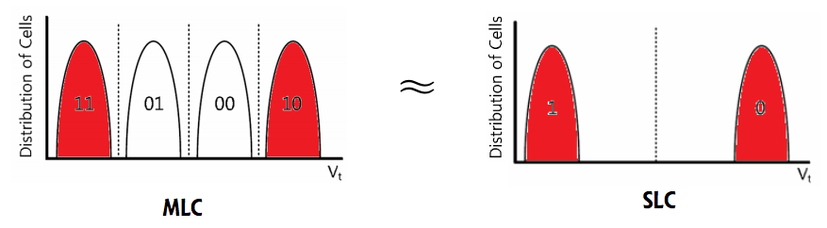
Background
(1) MLC programming method
Uses all four values of cell by writing data to both LSB and MSB bits
Low performance / High capacity (2 bits per cell)
(2) SLC programming method
Uses only two values of cell by writing data to LSB bit (or MSB bit)
High performance / Low capacity (1 bit per cell)

Slide 18
The Approach
Proposes a flash file system called FlexFS
Exploits flexible cell programming
Provides the high performance of SLC flash memory and the capacity of MLC flash memory
Provides a mechanism that copes with a poor wear characteristic of MLC flash memory
Designed for mobile systems, such as mobile phones

Slide 19
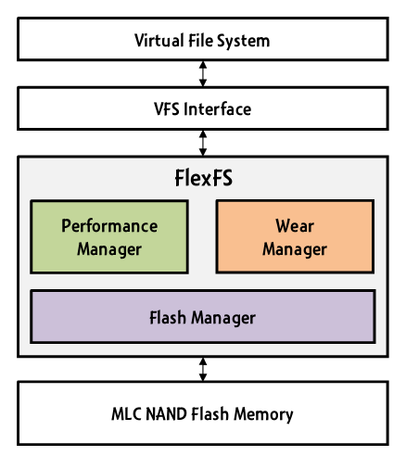
Architecture of FlexFS
Flash Manager
Manages heterogeneous cells
Performance manager
Exploits I/O characteristics
To achieve the high performance and high capacity
Wear manager
Guarantees a reasonable lifetime
Distributes erase cycles evenly

Slide 20
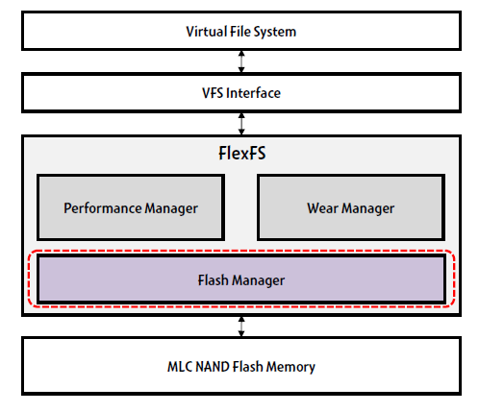
Overall Architecture

Slide 21
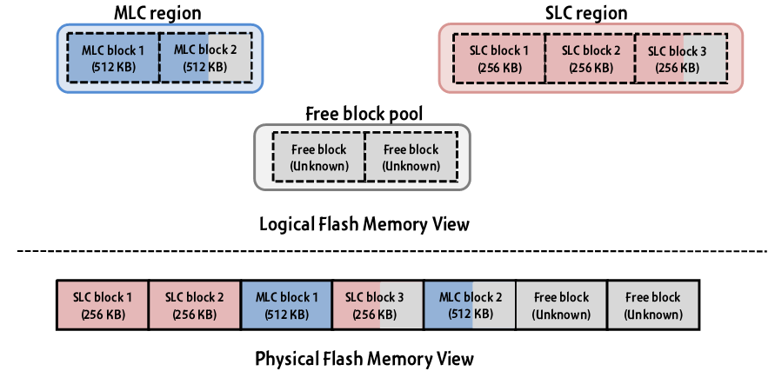
FlexFS - Flash Manager
Handles Heterogeneous Cells
Three types of flash memory block: SLC block, MLC block, and free block
Manages them as two regions and one free block pool

Slide 22
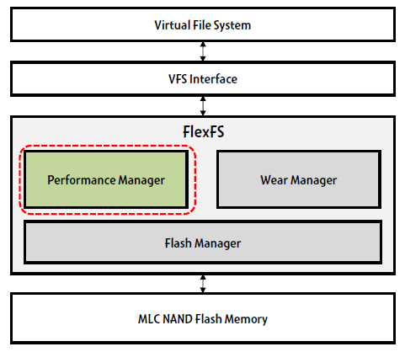
Overall Architecture

Slide 23
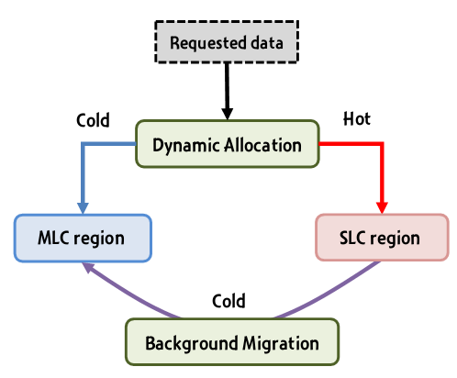
FlexFS – Performance Manager
Manages SLC and MLC regions
Provide SLC performance and MLC capacity
Exploits I/O characteristics, such as idle time and locality
Three key techniques
Dynamic allocation
Background migration
Locality-aware data management

Slide 24
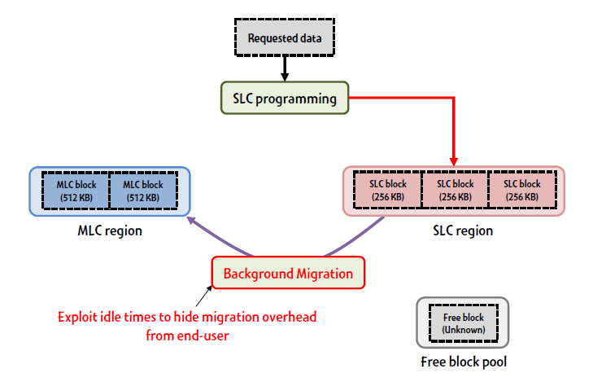
Baseline Approach

Slide 25
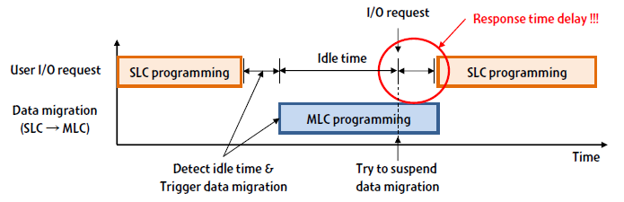
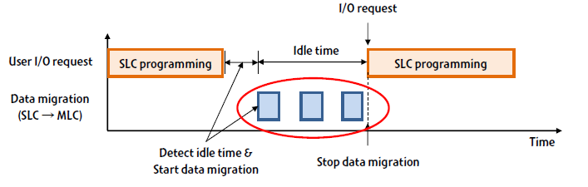
Background Migration

Slide 26

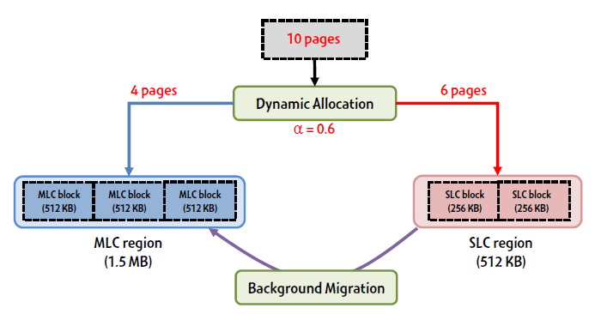
Dynamic Allocation
Distributes the incoming data across two regions depending on α
input data
T_{copy} is the time required to copy a single page from SLC to MLC
N_{p} is the number of pages in SLC
T_{predict} is the idle time of next time window predicted

Slide 27
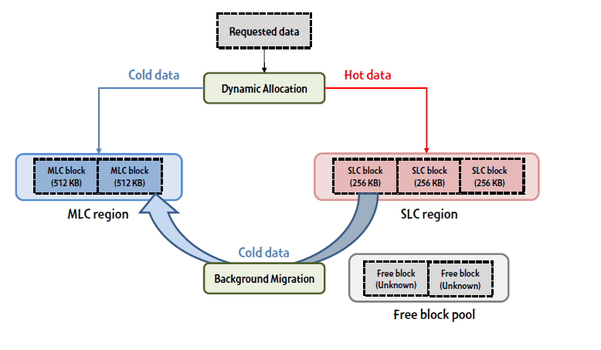
Locality-aware Data Management
Data migration for hot data is unnecessary
2Q-based locality detection*
* E. O’Neil, P. O’Neil, and G. Weikum, “The LRU-K Page Replacement Algorithm for Database Disk Buffering,” In Proceedings of the Conference on Management of Data (SIGMOD ’93), May 1993.

Slide 28
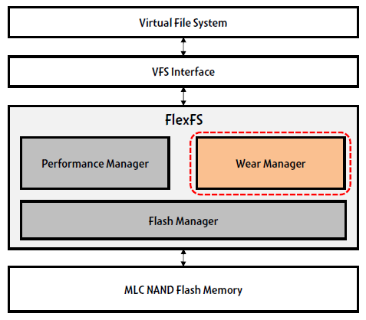
Overall Architecture

Slide 29
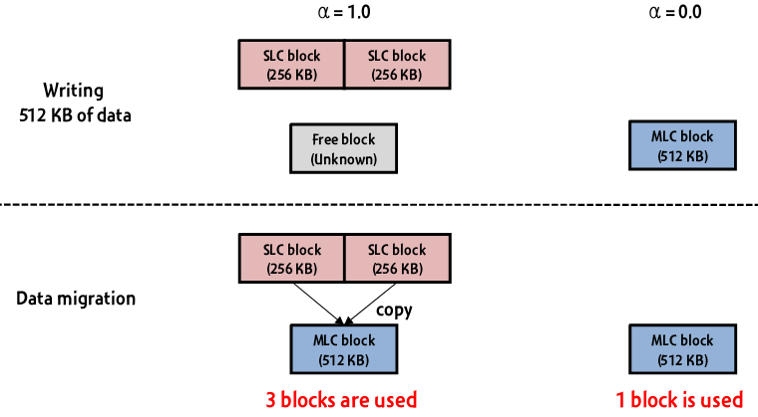
FlexFS– wearing rate control
How FlexFS control the wearing rate
The wearing rate is directly proportional to α

Slide 30
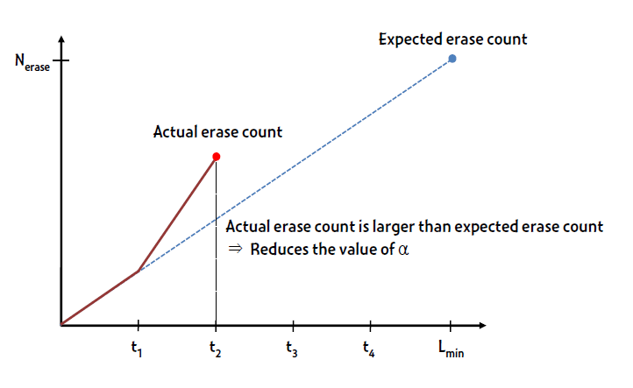
Wearing Rate Control

Slide 31
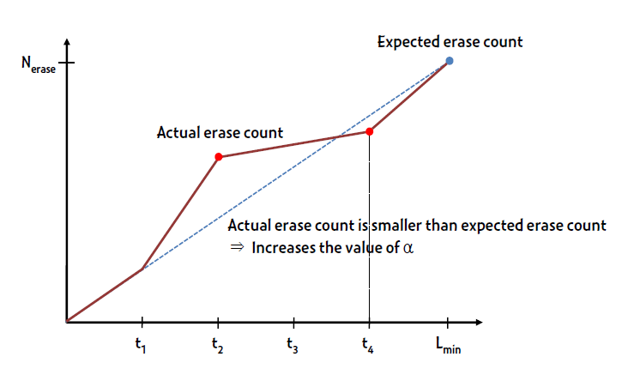
Wearing Rate Control

Slide 32
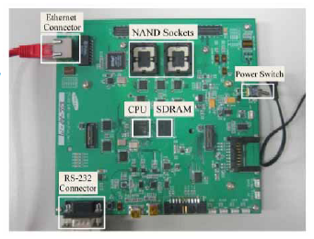
Conclusion
Propose a new file system for MLC NAND flash memory
Exploits the flexible cell programming to achieve the SLC performance and MLC capacity while ensuring a reasonable lifetime

Slide 33
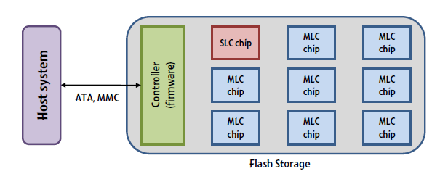
Other Solution
SLC/MLC hybrid storage [Chang et al (2008), Park et al (2008), Im et al (2009)]
Composed of a single SLC chip and many MLC chips
Uses the SLC chip as a write buffer for MLC chips
Redirects frequently accessed small data into the SLC chip
Redirects bulk data into the MLC chips
Q: If using this design for an FS, which data should be put to SLC? Which to MLC?

Slide 34
Log-based File Systems

Slide 35
Reevaluating Disk Performance
How has computer hardware been evolving?
RAM has become cheaper and grown larger :)
Random access seek times have remained very slow :(
This changing dynamic alters how disks are used
More data can be cached in RAM = less disk reads
Thus, writes will dominate disk I/O
Can we create a file system that is optimized for sequential writes?

Slide 36
Log-structured File System
Key idea: buffer all writes (including meta-data) in memory
Write these long segments to disk sequentially
Treat the disk as a circular buffer, i.e. don’t overwrite
Advantages:
All writes are large and sequential
Big question:
How do you manage meta-data and maintain structure in this kind of design?

Slide 37
Treating the Disk as a Log
Same concept as data journaling
Data and meta-data get appended to a log
Stale data isn’t overwritten, its replaced
Data Block 1
Data Block 2
inode
1
Data Block 5
inode
2
Data Block 1
inode
1
Disk

Slide 38
Buffering Writes
LFS buffers writes in-memory into chunks
Data Block 1
Data Block 2
Data Block 3
Data Block 4
inode
1
Data Block 5
inode
2
Memory
Giant Log
Disk
Chunks get appended to the log once they are sufficiently large

Slide 39
How to Find inodes
In a typical file system, the inodes are stored at fixed locations (relatively easy to find)
How do you find inodes in the log?
Remember, there may be multiple copies of a given inode
Solution: add a level of indirection
The traditional inode map can be broken into pieces
When a portion of the inode map is updated, write it to the log!

Slide 40
inode Maps
Data Block 1
Data Block 2
Data Block 3
Data Block 4
inode
1
Data Block 5
inode
2
inode
map
N
Memory
Giant Log
Disk
New problem: the inode map is scattered throughout the log
How do we find the most up-to-date pieces?

Slide 41
The Checkpoint Region
The superblock in LFS contains pointers to all of the up-to-date inode maps
The checkpoint region is always cached in memory
Written periodically to disk, say ~30 seconds
Only part of LFS that isn’t maintained in the log
CR
Data Block 1
Data Block 2
Data Block 3
Data Block 4
inode
1
Data Block 5
inode
2
inode
map
N
Disk

Slide 42
How to Read a File in LFS
Suppose you want to read inode 1
Look up inode 1 in the checkpoint region
inode map containing inode 1 is in sector X
Read the inode map at sector X
inode 1 is in sector Y
Read inode 1
File data is in sectors A, B, C, etc.
CR
Data Block 1
Data Block 2
Data Block 3
Data Block 4
inode
1
Data Block 5
inode
2
inode
map
N
Disk

Slide 43
Directories in LFS
Directories are stored just like in typical file systems
Directory data stored in a file
inode points to the directory file
Directory file contains name → inode mappings
CR
Data Block 1
Data Block 2
Data Block 3
Data Block 4
inode
1
Dir Data 1
inode
2
inode
map
N
Disk

Slide 44
Garbage
Over time, the log is going to fill up with stale data
Highly fragmented: live data mixed with stale data
Periodically, the log must be garbage collected
Data Block 1
Data Block 2
inode
1
Data Block 5
inode
2
Data Block 1
inode
1
Disk

Slide 45
Garbage Collection in LFS
Each cluster has a summary block
Contains the block → inode mapping for each block in the cluster
To check liveness, the GC reads each file with blocks in the cluster
If the current info doesn’t match the summary, blocks are stale
Which blocks are stale?
Pointers from other clusters are invisible
S
D1.1
D1.2
i1
D2.1
i2
Memory
Summary block
Disk
S
D1.1
D1.2
i1
D2.1
i2
S
D1.1
i1
D3.1
D3.2
D3.3
S
D1.2
D2.1
i2
i1
Cluster 1
Cluster 2

Slide 46
Segment Summary
For each data block in the segment, the summary describes:
the inode number N of the inode that owns the block
the offset F of the block inside the inode’s data region (e.g., “this block is at byte offset 4096”)
Using the summary, the cleaner determines whether a data block is live by:
reading inode N (either from the buffer cache or from disk via the inode map)
finding the appropriate data pointer for offset F, and seeing whether that pointer points to the data block in the segment being examined

Slide 47
Segment Summary
When live data blocks are written to a new segment, the cleaner must also write new versions of the corresponding inodes and imap entries
The inode map indicates which inodes are live, and each on-disk inode struct contains the inode number
So, when the cleaner finds inodes in an old segment, the cleaner can check the inode map to see whether the inodes should be written to a new segment

Slide 48
LFS Failure Recovery
Checkpoint and roll-forward
Recovery is very fast
No fsck, no need to check the entire disk
Recover the last checkpoint, and see how much data written after the checkpoint you can recover
Some data written after a checkpoint may be lost
Seconds versus hours

Slide 49
An Idea Whose Time Has Come
LFS seems like a very strange design
Totally unlike traditional file system structures
Doesn’t map well to our ideas about directory hierarchies
Initially, people did not like LFS
However, today its features are widely used

Slide 50
File Systems for SSDs
Let’s revist SSD hardware constraints
To implement wear leveling, writes must be spread across the blocks of flash
Periodically, old blocks need to be garbage collected to prevent write-amplification
Does this sounds familiar?
LFS is the ideal file system for SSDs!
Internally, SSDs manage all files in a LFS
This is transparent to the OS and end-users
Ideal for wear-leveling and avoiding write-amplification

Slide 51
Copy-on-write
Modern file systems incorporate ideas from LFS
Copy-on-write semantics
Updated data is written to empty space on disk, rather than overwriting the original data
Helps prevent data corruption, improves sequential write performance
Pioneered by LFS, now used in ZFS and btrfs
btrfs will probably be the next default file system in Linux

Slide 52
Versioning File Systems
LFS keeps old copies of data by default
Old versions of files may be useful!
Example: accidental file deletion
Example: accidentally doing open(file, ‘w’) on a file full of data
Turn LFS flaw into a virtue
Many modern file systems are versioned
Old copies of data are exposed to the user
The user may roll-back a file to recover old versions
[CCS’17] FlashGuard: Leveraging Intrinsic Flash Properties to Defend Against Encryption Ransomware

